Slide 1
Lecture 16
Discrete and Continuous Probability Distributions

Slide 2
Review
1 What are independent events?
Events where one occurring does not change the probability of the other.
2 What is a random variable?
The outcome of a random trial recorded as a number.
3 What is a discrete random variable?
One whose possible values can be listed, like the number of heads in 3 tosses.
4 What is a probability distribution?
A function giving each value of X a probability between 0 and 1; they add to 1.

Slide 3
The mean of a random variable
expected value μ
the long-run average of X: μ = Σ x · P(x)
variance σ²
σ² = Σ (x − μ)² · P(x), and the standard deviation is σ = √σ²
three coin tosses
μ = 0(1/8) + 1(3/8) + 2(3/8) + 3(1/8) = 1.5 heads

Slide 4
Example: grade points
A STAT 251 exam grade on the 4-point scale, for a student chosen at random:
x | 0 | 1 | 2 | 3 | 4
grade | F | D | C | B | A
P(x) | 0.05 | 0.10 | 0.30 | 0.25 | 0.30
(a) What is P(better than a C)?
(b) What is the mean grade, μ?
(a) P(X = 3) + P(X = 4) = 0.25 + 0.30 = 0.55
(b) μ = 0(0.05) + 1(0.10) + 2(0.30) + 3(0.25) + 4(0.30) = 2.65

Slide 5
Bernoulli trials
Bernoulli trial
one trial with two outcomes: success (X = 1) with probability p, failure (X = 0) with probability 1 − p
X ~ Bernoulli(p)
its single parameter p is the probability of success
mean and variance
μ = p and σ² = p(1 − p)

Slide 6
Example: guessing one question
You guess on a multiple-choice question with 4 options, one of them correct.
X = 1 if the guess is right, X = 0 if not; p = 1/4 = 0.25
(a) What is P(X = 0)?
(b) What are μ and σ²?
(a) 1 − 0.25 = 0.75
(b) μ = 0.25, σ² = 0.25 × 0.75 = 0.1875

Slide 7
The binomial setting
a fixed number of trials n
the trial is repeated a set number of times, decided in advance
two outcomes, the same p
each trial is a success or a failure, with the same probability of success p every time
independent trials
the outcome of one trial does not change the probability of success on any other

Slide 8
The binomial distribution
X ~ Binom(n, p)
X = the number of successes in n independent trials, each with probability of success p
P(X = k)
n! / (k!(n − k)!) · p^{k} · (1 − p)^{n−k}: the first factor counts the ways to arrange k successes
mean and variance
μ = np and σ² = np(1 − p)

Slide 9
Example: counting vs. the formula
Monday: X = the number of heads in 3 tosses of a fair coin, counted straight from the sample space.
S = {HHH, HHT, HTH, THH, HTT, THT, TTH, TTT}; X ~ Binom(n = 3, p = 0.5)
(a) From S, what are P(X = 3) and P(X = 2)?
(b) Use the formula to find P(X = 3) and P(X = 2).
(c) What does 3! / (2! 1!) count?
(a) 1/8 (HHH) and 3/8 (HHT, HTH, THH)
(b) 3!/(3! 0!) · 0.5³ · 0.5⁰ = 1/8 3!/(2! 1!) · 0.5² · 0.5¹ = 3/8: the same
(c) the 3 orders with 2 heads: HHT, HTH, THH

Slide 10
Example: guessing a whole quiz
You guess on all 10 questions of a 4-option multiple-choice quiz.
X ~ Binom(n = 10, p = 0.25)
(a) What is P(X = 3)?
(b) What is P(X = 0)?
(c) What are μ and σ?
(a) 10!/(3! 7!) · 0.25³ · 0.75⁷ = 120 × 0.0156 × 0.1335 ≈ 0.250
(b) 0.75¹⁰ ≈ 0.056
(c) μ = 10 × 0.25 = 2.5, σ = √(10 × 0.25 × 0.75) ≈ 1.37

Slide 11
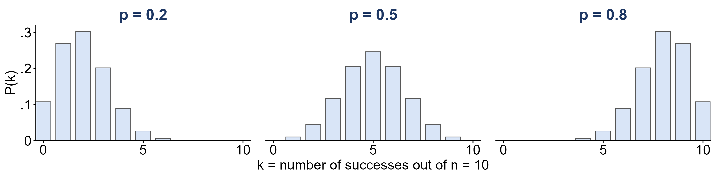
The shape of a binomial distribution
X ~ Binom(n = 10, p) for three values of p.
What does p do to the shape?
p = 0.5: symmetric. p < 0.5: skewed right. p > 0.5: skewed left.
The center sits at μ = np: 2, 5 and 8

Slide 12
Example: free throws
Stephen Curry has made 4,236 of the 4,645 free throws he has attempted in the NBA.
p = 4,236 / 4,645 ≈ 0.912; he shoots n = 10; X = free throws made
(a) What is P(he makes all 10)?
(b) What is P(he misses at least one)?
(c) How many does he make, on average?
(a) 0.912¹⁰ ≈ 0.40
(b) 1 − 0.40 = 0.60
(c) μ = np = 10 × 0.912 ≈ 9.1

Slide 13
Is it binomial?
For each X, check the three conditions: fixed n, the same p, independent trials.
(a) X = the number of heads in 20 flips of a coin
(b) X = the number of aces in a 5-card hand
(c) X = the number of rolls of a die until the first six
(a) Yes: n = 20, p = 0.5, and the flips are independent
(b) No: the cards are dealt without replacement, so the draws are not independent
(c) No: the number of trials n is not fixed

Slide 14
The Poisson distribution
X ~ Poisson(λ)
X = the number of events in a fixed interval of time or space, when events occur independently at an average rate λ
P(X = k)
λ^{k} e^{−λ} / k!, k = 0, 1, 2, … (e ≈ 2.718)
mean and variance
μ = λ and σ² = λ

Slide 15
Example: World Cup goals
The 2022 FIFA World Cup had 172 goals in 64 matches.
λ = 172 / 64 ≈ 2.69 goals per match; X = goals in one match
(a) What is P(X = 0)?
(b) How many of the 64 matches does the model expect to end 0–0? (There were 7.)
(c) What is λ for one 45-minute half, and P(no goals in a half)?
(a) e^{−2.69} ≈ 0.068
(b) 64 × 0.068 ≈ 4.4: close, but a model is never a perfect fit
(c) λ = 2.69 / 2 ≈ 1.34, P(X = 0) = e^{−1.34} ≈ 0.26

Slide 16
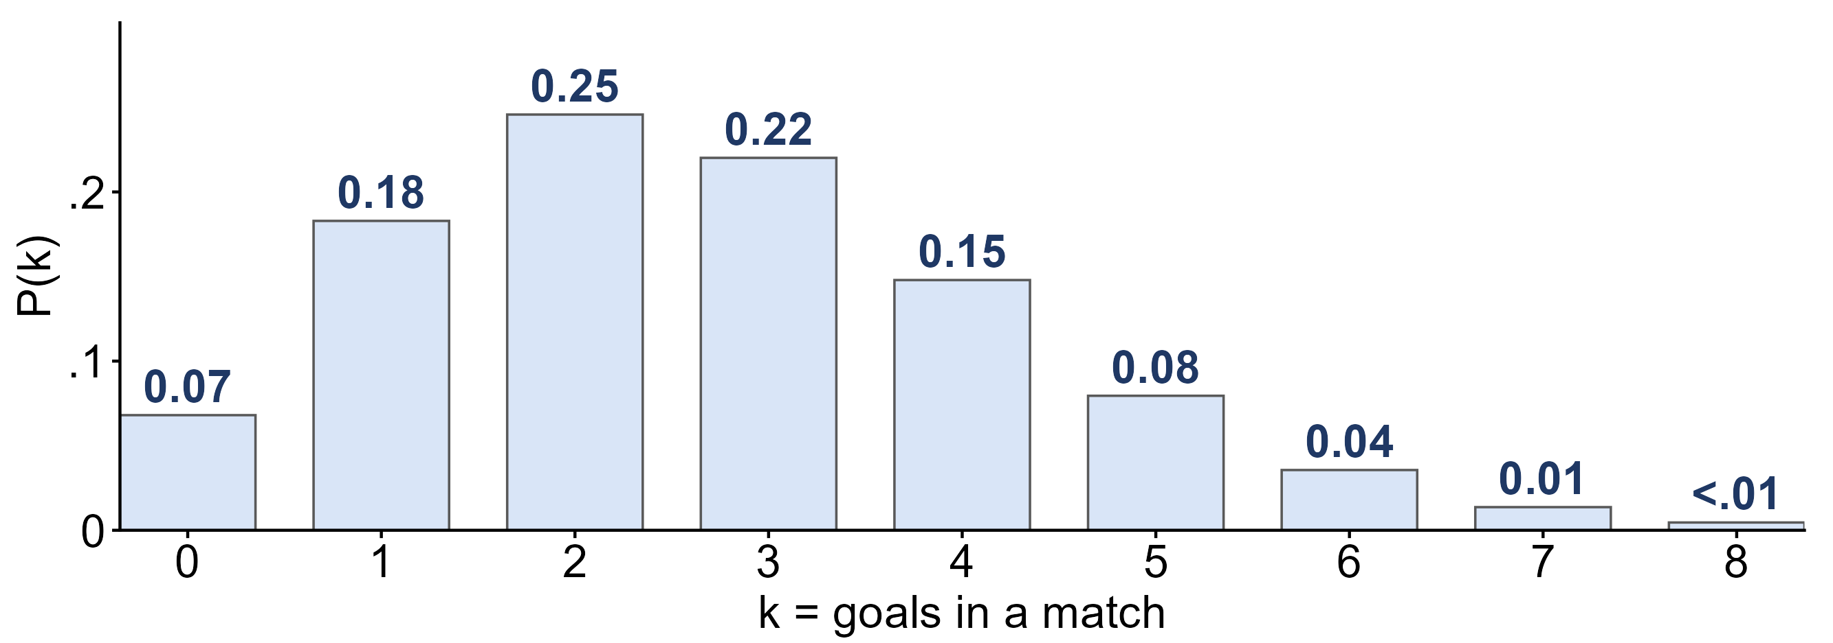
Goals per match: the Poisson model
X ~ Poisson(λ = 2.69): the probability of each number of goals in a match.
Which number of goals is most likely? Is the distribution symmetric?
Two goals (0.25), then three (0.22); skewed right: X cannot go below 0 but has no upper limit

Slide 17
Continuous random variables
density curve f(x)
the curve for a continuous X: it never goes below 0, and the total area under it is 1
probability is area
P(a < X < b) is the area under the curve between a and b; the height is not a probability
P(X = c) = 0
a single value has no width, so P(X < c) = P(X ≤ c)

Slide 18
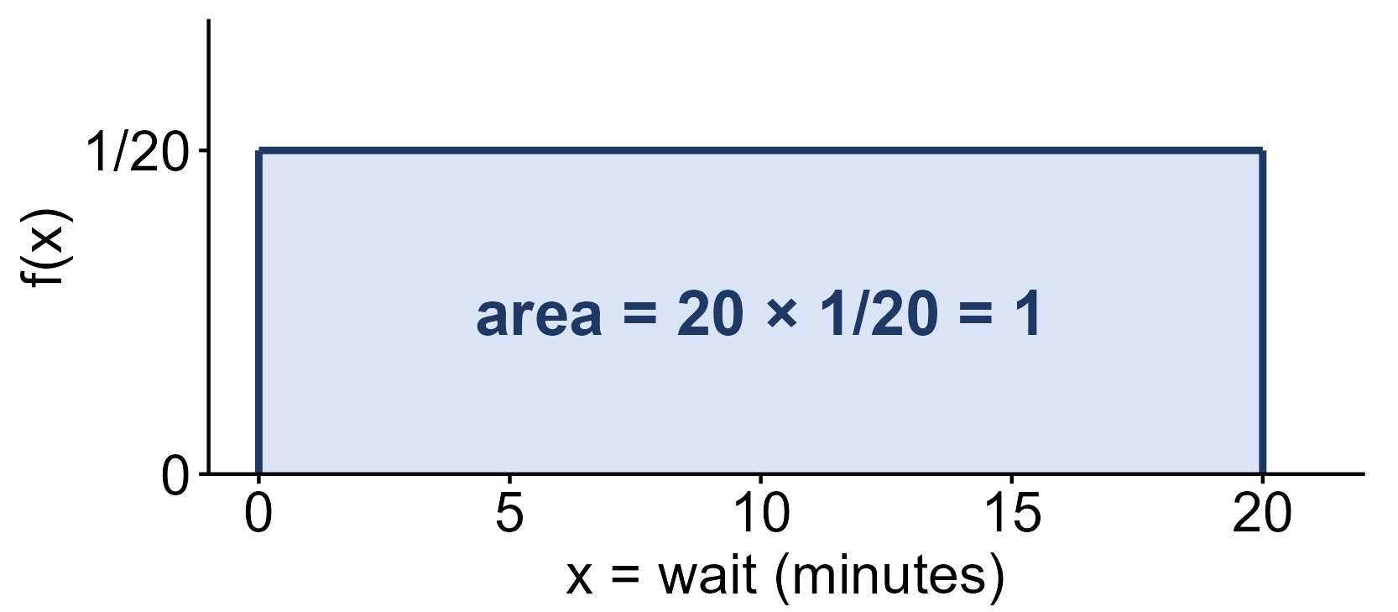
Example: waiting for the shuttle
A campus shuttle comes every 20 minutes, and you arrive at a random time.
X = your wait in minutes: f(x) = 1/20 for 0 ≤ x ≤ 20
(a) What is P(X < 5)?
(b) What is P(4 < X < 15)?
(c) What is P(X = 15)?
(a) 5 × 1/20 = 0.25
(b) (15 − 4) × 1/20 = 0.55
(c) 0: a single point has no width

Slide 19
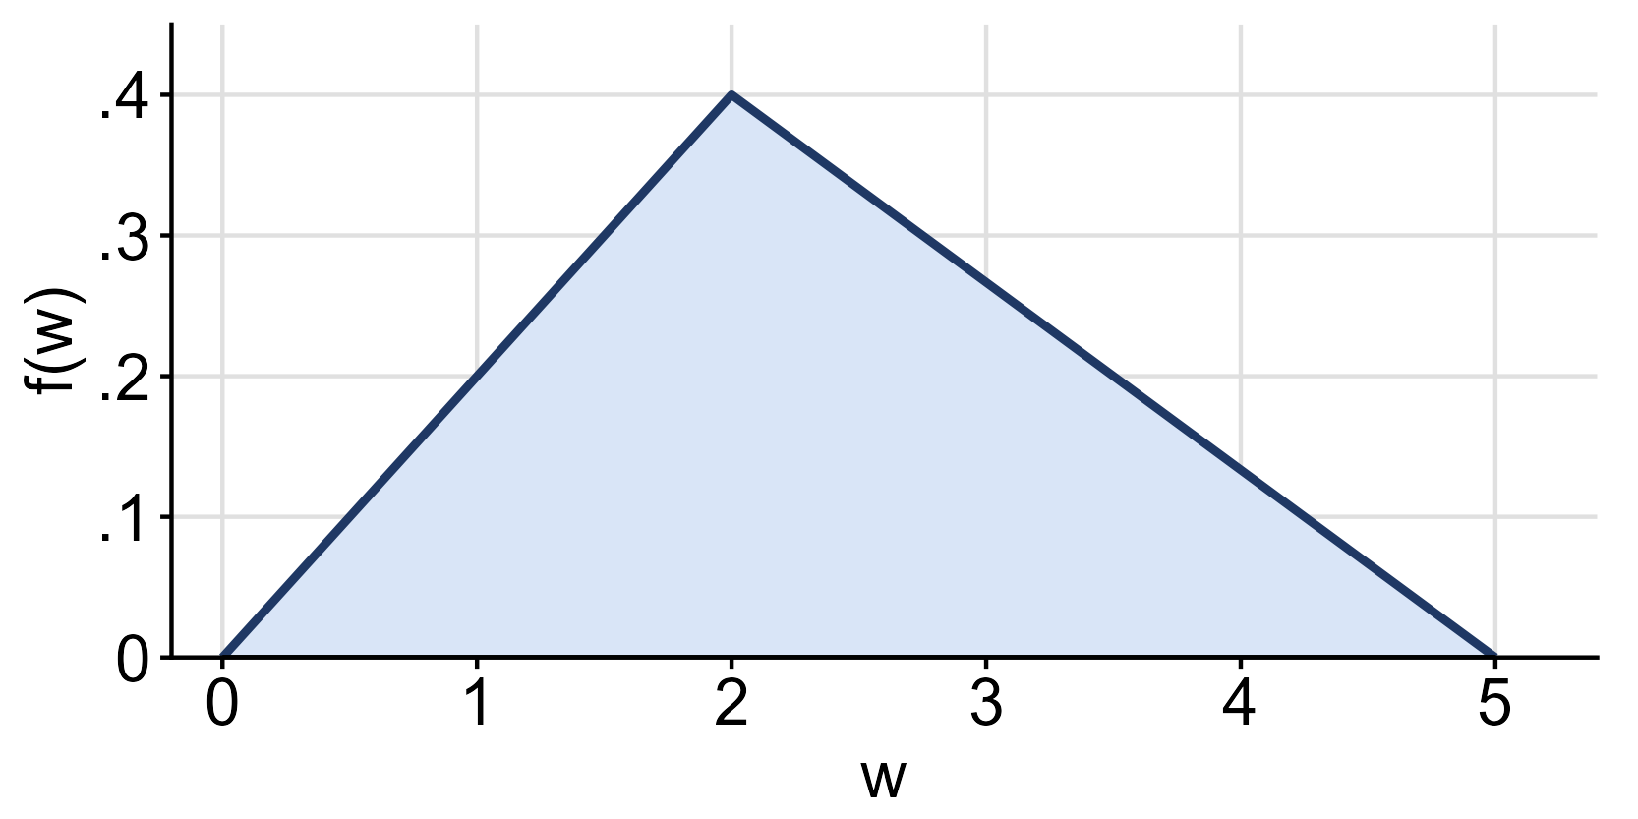
Example: a triangle
The density of W rises in a straight line to 0.4 at w = 2, then falls to 0 at w = 5.
(a) Is the total area 1?
(b) What is P(W ≤ 1)?
(c) What is P(W > 2)?
(a) ½ × 5 × 0.4 = 1
(b) ½ × 1 × 0.2 = 0.1 (the height at w = 1 is 0.2)
(c) ½ × 3 × 0.4 = 0.6

Slide 20
Cumulative probability
P(X ≤ x)
the area to the left of x: what the z-table and pnorm give
area to the right
P(X > x) = 1 − P(X ≤ x)
area between
P(a < X < b) = P(X ≤ b) − P(X ≤ a)

Slide 21
Example: area between
X = the height of a woman in the student heights data, modeled as normal.
X ~ N(65.4, 3.38); Week 6: P(X < 70) = 0.9131
(a) What is P(X > 70)?
(b) What is P(X < 62)?
(c) What is P(62 < X < 70)?
(a) 1 − 0.9131 = 0.0869
(b) z = (62 − 65.4) / 3.38 = −1.01: table gives 0.1562
(c) 0.9131 − 0.1562 = 0.7569 ≈ 0.76

Slide 22
What you should know: distributions
expected value
μ = Σ x P(x): the long-run average of X
binomial
successes in n independent trials with the same p: μ = np, σ² = np(1 − p); Bernoulli is n = 1
Poisson
events in a fixed interval at an average rate λ: μ = σ² = λ
continuous
probability is area under the density curve; P(X = c) = 0; P(a < X < b) = P(X ≤ b) − P(X ≤ a)

